Slide 1

Objects in PowerShell

Slide 2
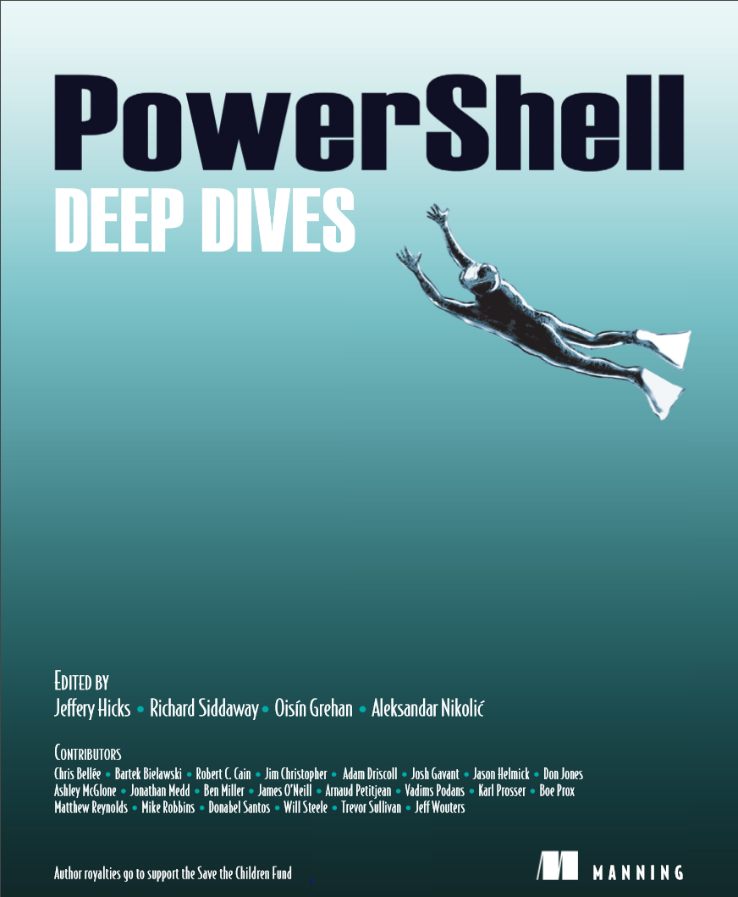
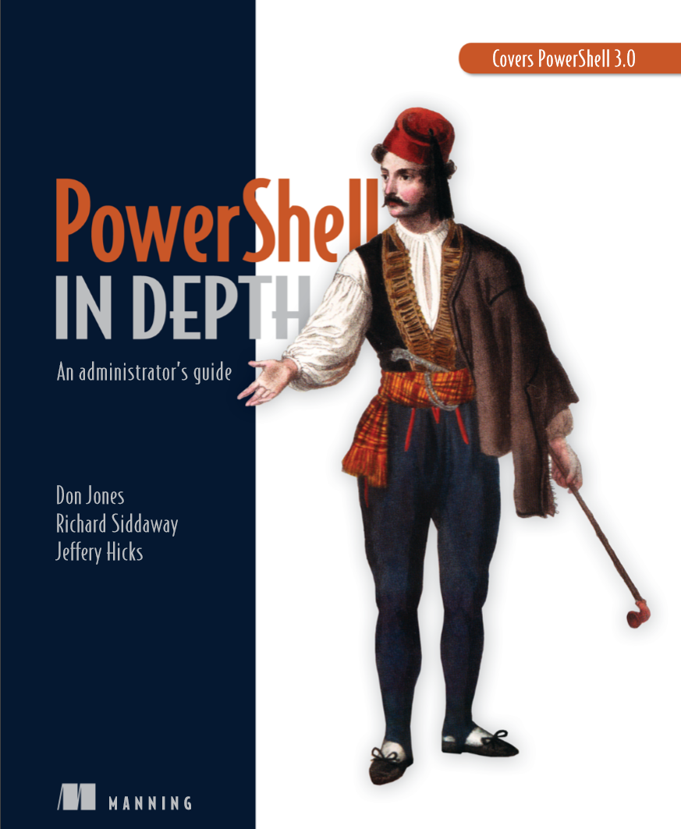
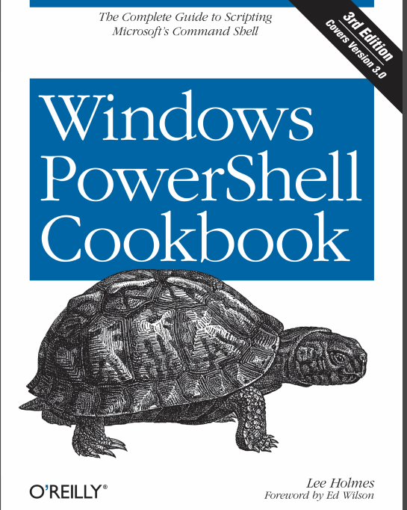
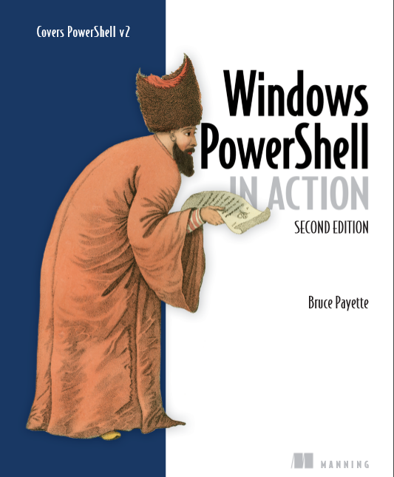
Great PowerShell books
Non-exhaustive list

Slide 3
Objects… what are those?
In the class-based object-oriented programming paradigm, "object" refers to a particular instance of a class where the object can be a combination of variables, functions, and data structures. - Wikipedia

Slide 4
Objects… Some vocabulary?
Class
Instance of a class = Object
Inheritance
Property
Method

Slide 5
What Type kind of objects?
.Net Objects
PowerShell Objects
WMI / CIM

Slide 6
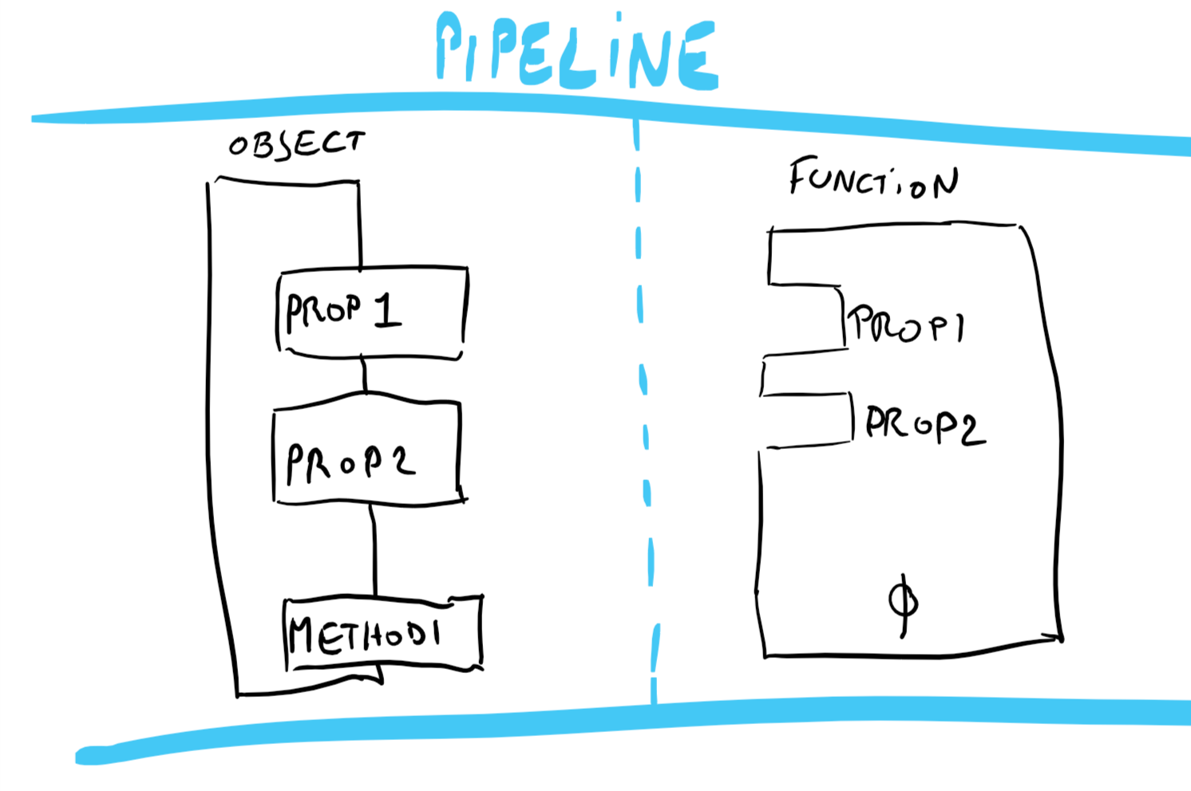
It’s all about the Pipeline

